Slide 1

Introduction to Deep Learning
Supervised Learning
with Neural Networks
deeplearning.ai

Slide 2


Neural Network examples
Standard NN
Convolutional NN
Recurrent NN

Slide 3
Why is Deep Learning taking off?
More data
More computational resources
New algorithms

Slide 4

Deep learning is highly iterative process
Idea
Experiment
Code

Slide 5
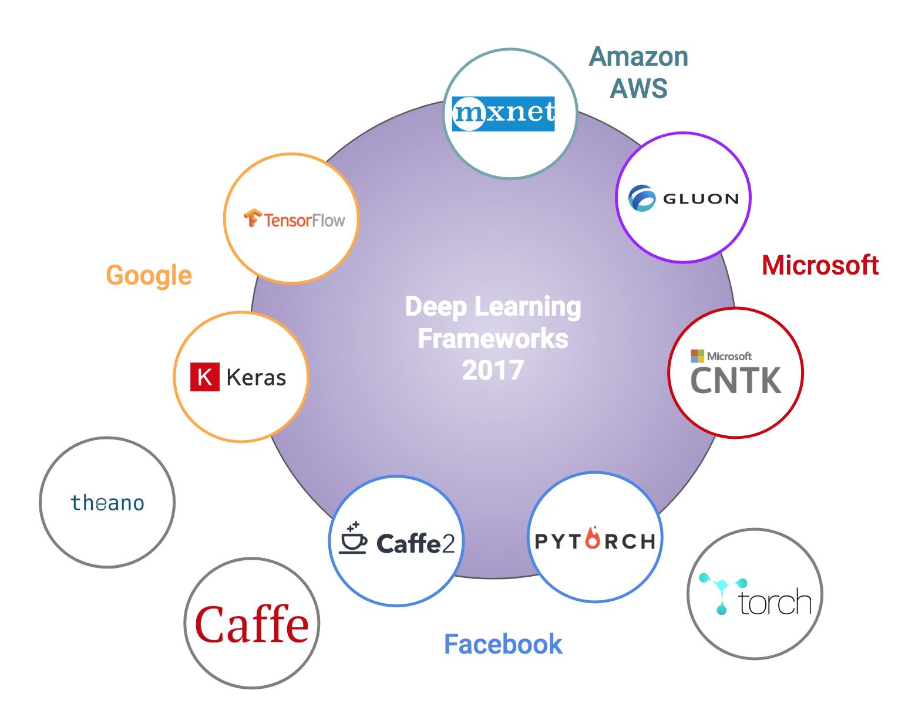

Slide 6
Binary Classification
1 (cat) vs 0 (non cat)
Blue
Green
Red

Slide 7
Notation

Slide 8
Logistic Regression
http://vision.stanford.edu/teaching/cs231n-demos/linear-classify/

Slide 9
Logistic Regression cost function
$\hat{y} = σ\left(w^{T}x +b\right)$, where $σ\left(z \right)=\frac{1}{1+e^{−z}}$
Given $\left\{{(x}^{(1)},y^{(1)}\text{)}\text{,}\text{…}\text{,}{(x}^{(m)},y^{(m)}\text{)}\right\},$want ${\hat{y}}^{(i)}≈y^{\left(i\right)}$.
Loss (error) function:

Slide 10
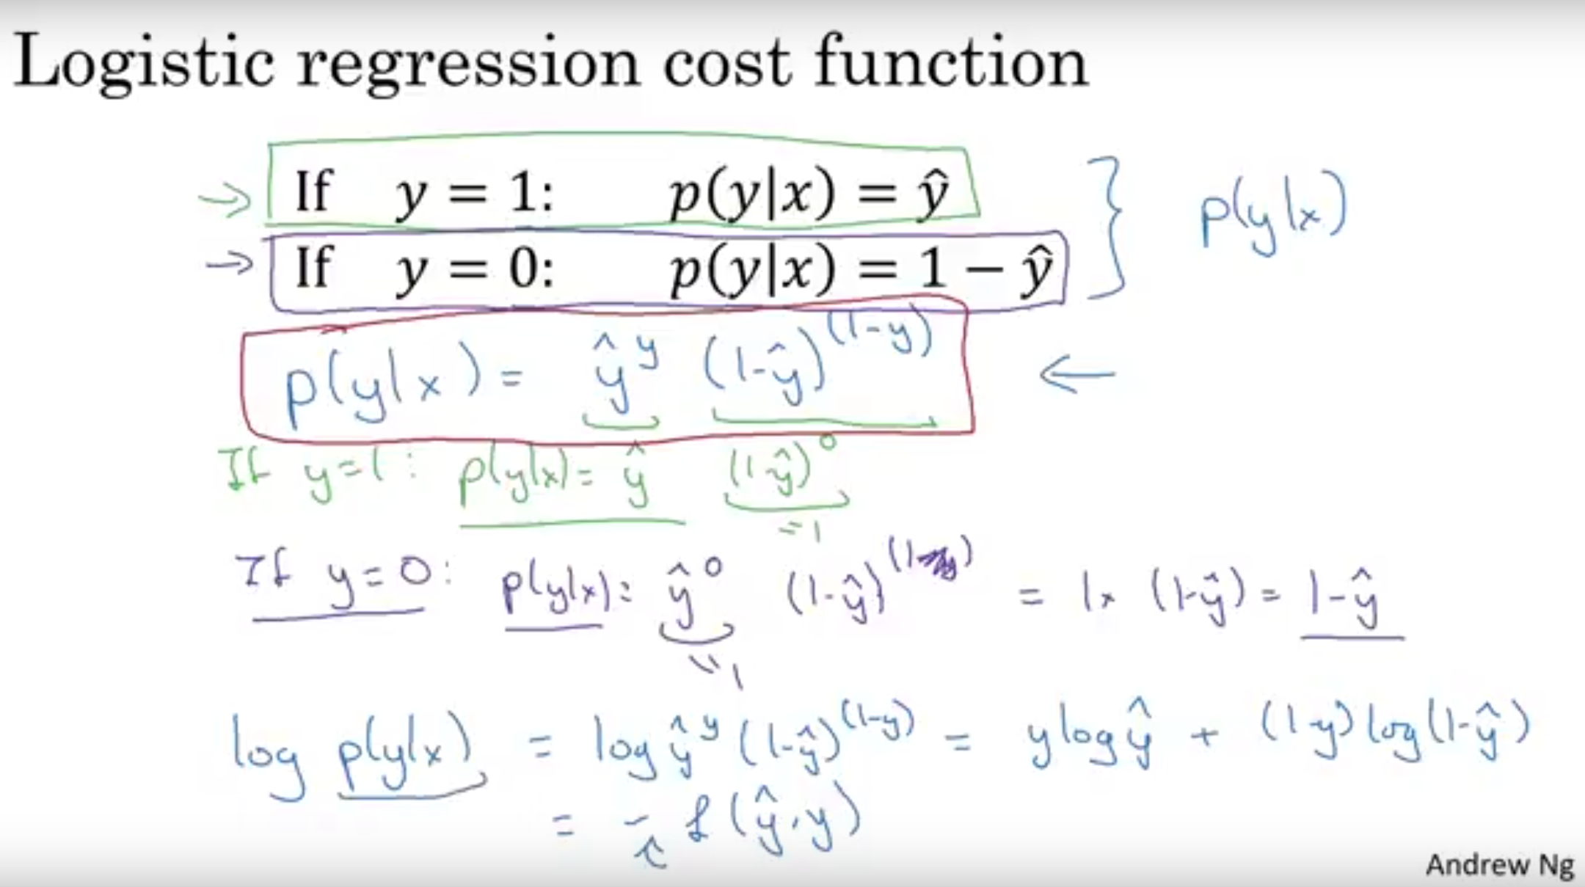

Slide 11
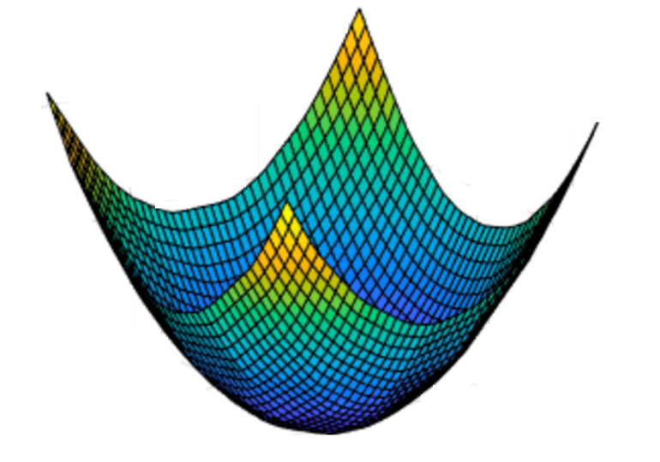
Gradient Descent
Recap: $\hat{y}= σ\left(w^{T}x+b\right)$, $σ\left(z\right)=\frac{1}{1+e^{−z}}$
$$\frac{1}{m}\sum_{i=1}^{m}{ }$$
$ℒ({\hat{y}}^{\left(i\right)},y^{(i)})$ $=$
$$−\frac{1}{m}\sum_{i=1}^{m}{ }$$
$$J\left(w,b\right)=$$
$y^{(i)}\log{{\hat{y}}^{\left(i\right)}}$+ $({1−y}^{(i)})\log{(1 −{\hat{y}}^{\left(i\right)})}$
Want to find $w,b$ that minimize $J\left(w,b\right)$
$$J\left(w,b\right)$$
$$b$$
$$w$$

Slide 12
Gradient Descent
$$w$$

Slide 13

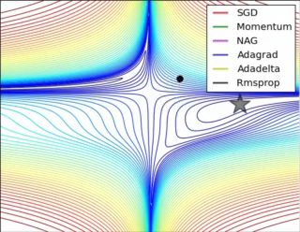
Optimization methods

Slide 14
Basics of Neural Network Programming
Computation Graph
deeplearning.ai

Slide 15
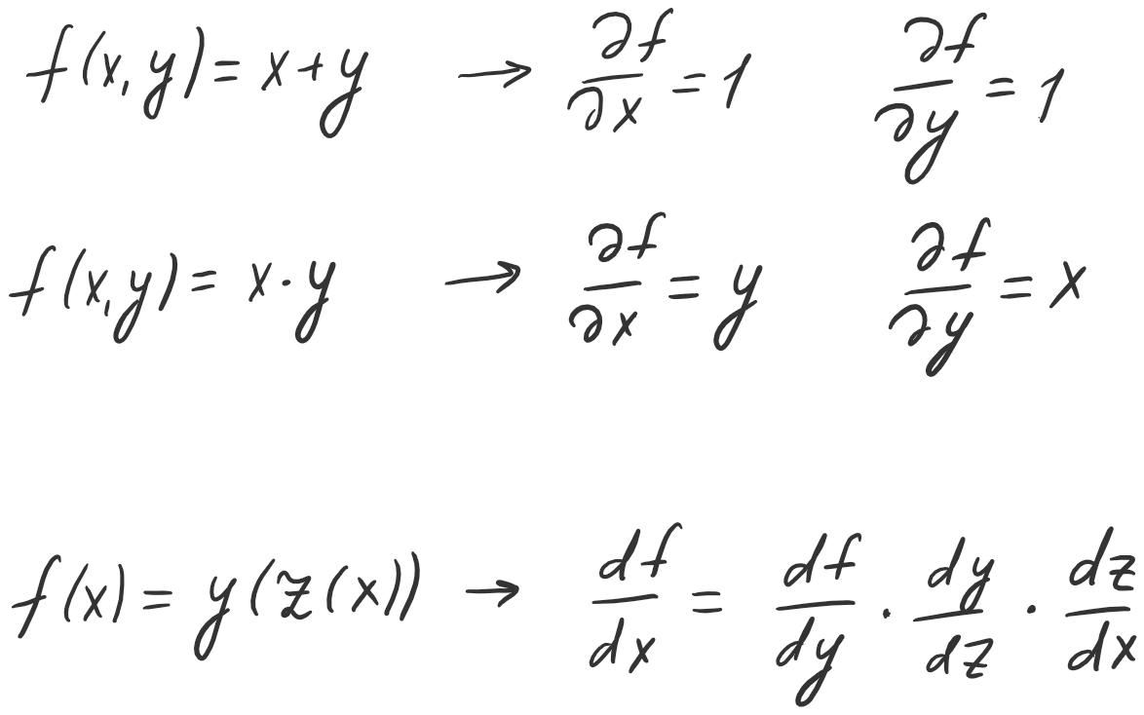
Derivatives

Slide 16
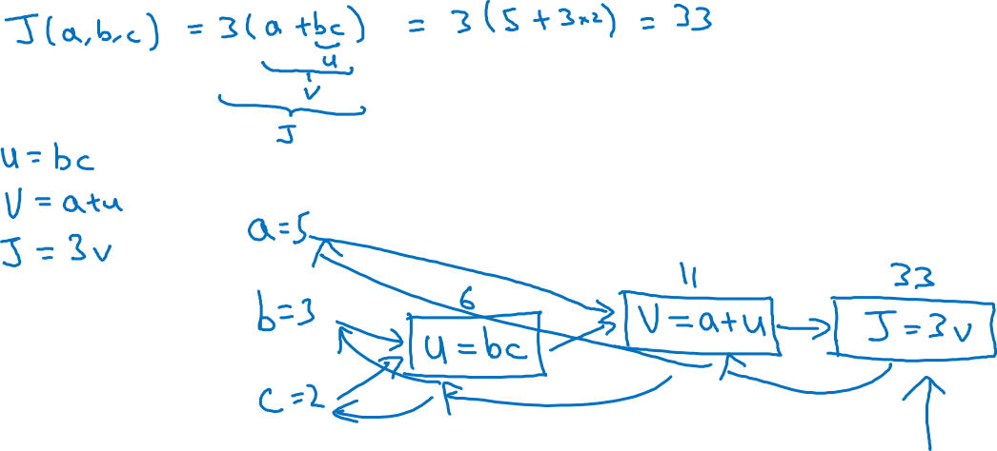
Computation Graph

Slide 17
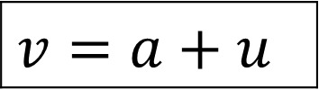
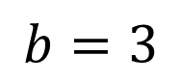
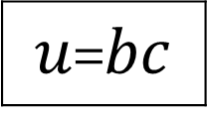
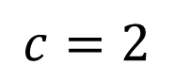
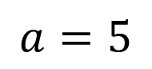
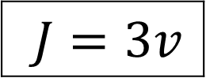
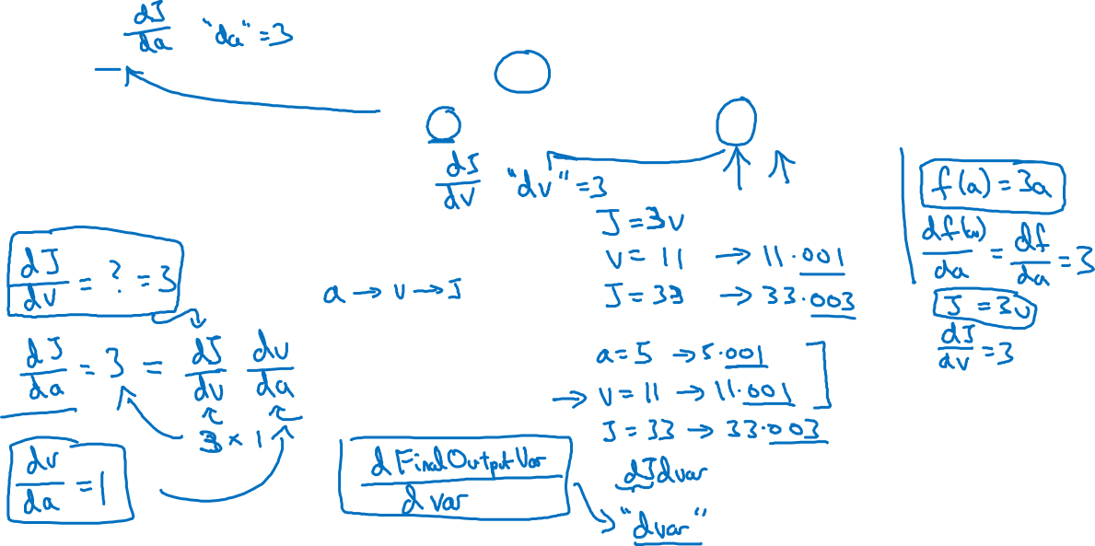
Computing derivatives
$$a=5$$
11
33
$$b=3$$
6
$$v=a+u$$
$J=3v$
$u$=$bc$
$$c=2$$

Slide 18
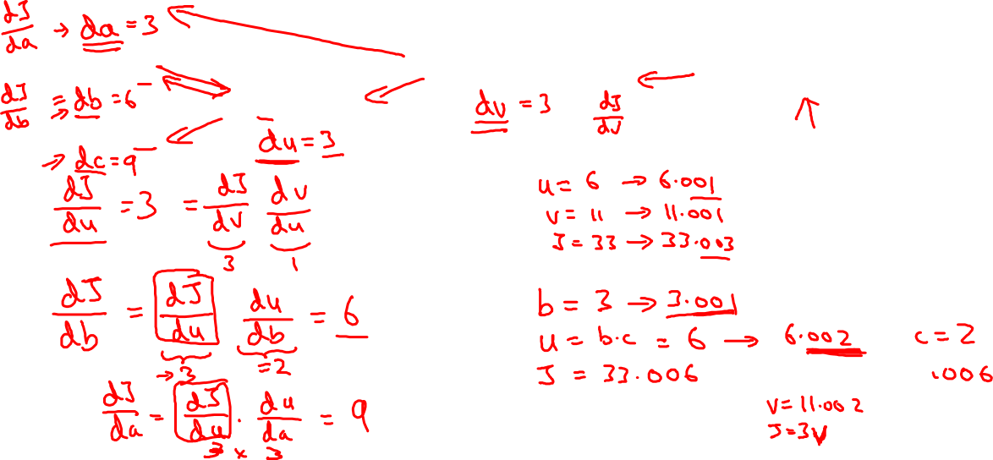
Computing derivatives
$$a=5$$
11
33
$$b=3$$
6
$$v=a+u$$
$J=3v$
$u$=$bc$
$$c=2$$

Slide 19
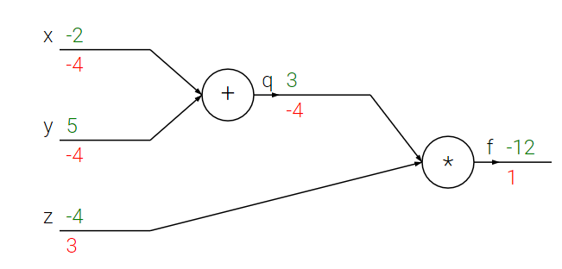
Computational graph
f(x, y, z) = (x + y) * z

Slide 20
Computational graph
f(x, y, z) = (x + y) * z

Slide 21
Computational graph
f(x, y, z) = (x + y) * z

Slide 22
Computational graph
f(x, y, z) = (x + y) * z

Slide 23
Computational graph
f(x, y, z) = (x + y) * z

Slide 24
Computational graph
f(x, y, z) = (x + y) * z

Slide 25
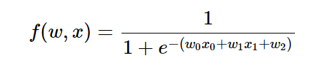
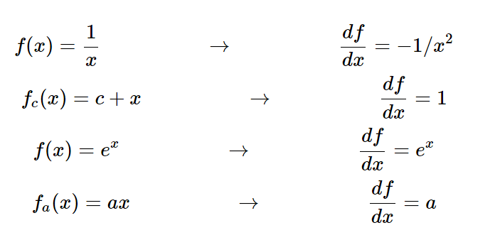
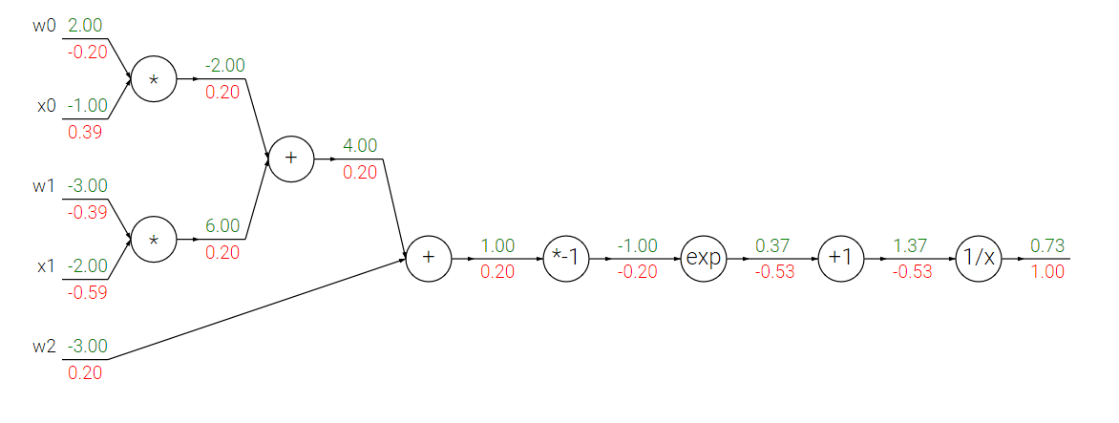
Logistic regression

Slide 26
Logistic regression

Slide 27
Basics of Neural Network Programming
Logistic Regression
Gradient descent
deeplearning.ai

Slide 28
Logistic regression recap
$$z= w^{T}x+b$$
$$\hat{y}=a= σ(z)$$
$$ℒ\left(a,y\right)=−(y\log{(a)+(1−y)\log{(1−a))}}$$

Slide 29
Logistic regression derivatives
$$x_{1}$$
$$w_{1}$$
$$x_{2}$$
$$z= w_{1}x_{1}+w_{2}x_{2}+b$$
$$a= σ(z)$$
$$ℒ(a,y)$$
$$w_{2}$$
b

Slide 30
Logistic regression on m examples

Slide 31
Logistic regression on m examples

Slide 32
Basics of Neural Network Programming
Vectorization
deeplearning.ai

Slide 33
What is vectorization?

Slide 34
Neural network programming guideline
Whenever possible, avoid explicit for-loops.

Slide 35
Vectors and matrix valued functions
Say you need to apply the exponential operation on every element of a matrix/vector.
$$v= \left[\begin{matrix}v_{1} \\ ⋮ \\ v_{n}\end{matrix}\right]$$
u = np.zeros((n,1))
for i in range(n):
u[i]=math.exp(v[i])

Slide 36
Logistic regression derivatives
J = 0, dw1 = 0, dw2 = 0, db = 0
for i = 1 to n:
$z^{(i)}$ = $w^{T}x^{(i)}+b$
$a^{(i)}$ = $σ{(z}^{(i)})$
$J$+= $−\left[y^{(i)} \log{{\hat{y}}^{\left(i\right)}+({1−y}^{\left(i\right)})\log{(1 −{\hat{y}}^{\left(i\right)})}}\right]$
d$z^{(i)}$ = $a^{(i)}{(1−a}^{(i)})$
d${w_{1}}^{ }$+= $x_{1}^{(i)}\text{d}z^{(i)}$
d${w_{2}}^{ }$+= $x_{2}^{(i)}\text{d}z^{(i)}$
db += d$z^{(i)}$
J = J/m, d$w_{1}$ = d$w_{1}$/m, d$w_{2}$ = d$w_{2}$/m, db = db/m

Slide 37
Basics of Neural Network Programming
Vectorizing Logistic
Regression
deeplearning.ai

Slide 38
Vectorizing Logistic Regression
$$z^{(1)}=w^{T}x^{(1)}+b$$
$$z^{(2)}=w^{T}x^{(2)}+b$$
$$z^{(3)}=w^{T}x^{(3)}+b$$
$$a^{(1)}={σ(z}^{(1)})$$
$$a^{(2)}={σ(z}^{(2)})$$
$$a^{(3)}={σ(z}^{(3)})$$

Slide 39
Vectorizing Logistic Regression

Slide 40
Implementing Logistic Regression
J = 0, d$w_{1}$ = 0, d$w_{2}$ = 0, db = 0
for i = 1 to m:
$z^{(i)}$ = $w^{T}x^{(i)}+b$
$a^{(i)}$ = $σ{(z}^{(i)})$
$J$+= $−\left[y^{(i)} \log{a^{\left(i\right)}+({1−y}^{\left(i\right)})\log{(1 −a^{\left(i\right)})}}\right]$
d$z^{(i)}$ = $a^{(i)}{−y}^{(i)}$
d${w_{1}}^{ }$+= $x_{1}^{(i)}\text{d}z^{(i)}$
d${w_{2}}^{ }$+= $x_{2}^{(i)}\text{d}z^{(i)}$
db += d$z^{(i)}$
J = J/m, d$w_{1}$ = d$w_{1}$/m, d$w_{2}$ = d$w_{2}$/m
db = db/m

Slide 41
One hidden layer
Neural Network
Neural Networks
Overview

Slide 42
What is a Neural Network?
$$x_{1}$$
$$x_{2}$$
$$\hat{y}$$
$$x_{3}$$
x
w
$$z=w^{T}x+b$$
$$a=σ(z)$$
$$ℒ(a,y)$$
b
$$x_{1}$$
$$x_{2}$$
$$\hat{y}$$
$$x_{3}$$
x
$$W^{[1]}$$
$$z^{[1]}=W^{[1]}x+b^{[1]}$$
$$a^{[1]}=σ(z^{[1]})$$
$$z^{[2]}=W^{[2]}a_{ }^{[1]}+b^{[2]}$$
$$a^{[2]}=σ(z^{[2]})$$
$$ℒ(a^{[2]},y)$$
$$b^{[1]}$$
$$W^{[2]}$$
$$b^{[2]}$$

Slide 43
Neural Network Representation
$$x_{1}$$
$$x_{2}$$
$$\hat{y}$$
$$x_{3}$$

Slide 44
Neural Network Representation
$$x_{1}$$
$$x_{1}$$
$$x_{2}$$
$$σ(z)$$
$$a=\hat{y}$$
$$x_{2}$$
$$\hat{y}$$
$$w^{T}x+b$$
$$z$$
$$a$$
$$x_{3}$$
$$x_{3}$$
$$z=w^{T}x+b$$
$$a=σ(z)$$

Slide 45
Neural Network Representation
$$x_{1}$$
$$x_{1}$$
$$x_{2}$$
$$σ(z)$$
$$a=\hat{y}$$
$$x_{2}$$
$$\hat{y}$$
$$w^{T}x+b$$
$$z$$
$$a$$
$$x_{3}$$
$$x_{3}$$
$$z=w^{T}x+b$$
$$x_{1}$$
$$a=σ(z)$$
$$x_{2}$$
$$\hat{y}$$
$$x_{3}$$

Slide 46
Neural Network Representation
$$a_{1}^{\left[1\right]}$$
$z_{1}^{\left[1\right]}=w_{1}^{{\left[1\right]T}^{ }}x+b_{1}^{[1]}, a_{ 1}^{[1]}=σ(z_{1}^{\left[1\right]}$)
$$x_{1}$$
$$a_{2}^{\left[1\right]}$$
$z_{2}^{\left[1\right]}=w_{2}^{{\left[1\right]T}^{ }}x+b_{2}^{[1]}, a_{ 2}^{[1]}=σ(z_{2}^{\left[1\right]}$)
$$x_{2}$$
$$\hat{y}$$
$$a_{3}^{\left[1\right]}$$
$z_{3}^{\left[1\right]}=w_{3}^{{\left[1\right]T}^{ }}x+b_{3}^{[1]}, a_{ 3}^{[1]}=σ(z_{3}^{\left[1\right]}$)
$$x_{3}$$
$$a_{4}^{\left[1\right]}$$
$z_{4}^{\left[1\right]}=w_{4}^{{\left[1\right]T}^{ }}x+b_{4}^{[1]}, a_{ 4}^{[1]}=σ(z_{4}^{\left[1\right]}$)

Slide 47
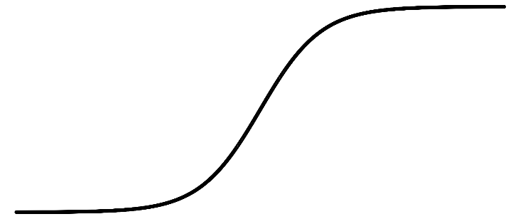
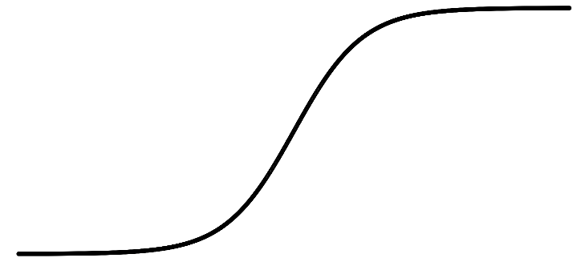
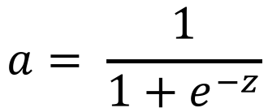
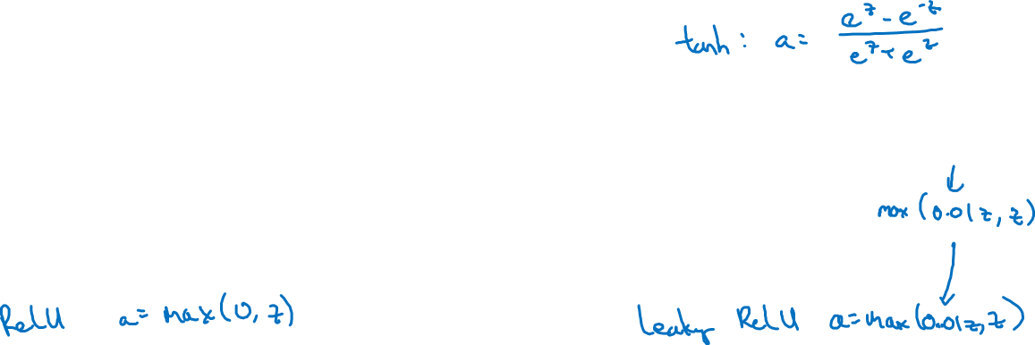
Activation functions
a
a
x
z
$$a= \frac{1}{1+e^{−z}}$$
sigmoid:
a
a
z
z

Slide 48
One hidden layer
Neural Network
Why do you
need non-linear
activation functions?

Slide 49
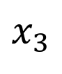
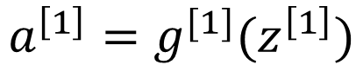
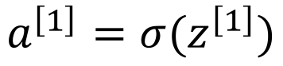
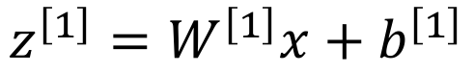
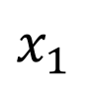
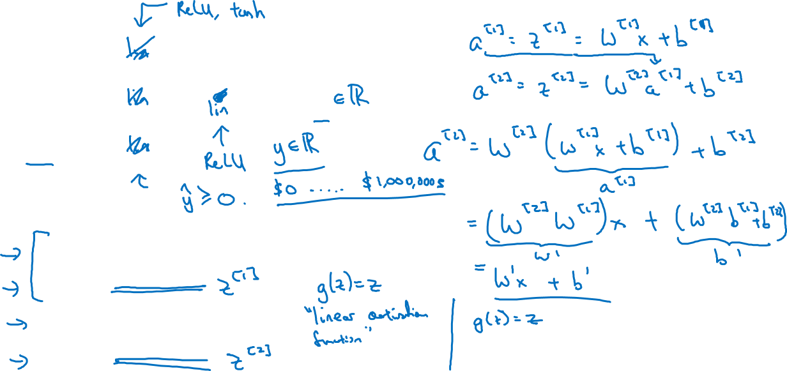
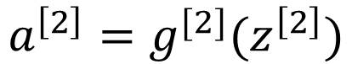
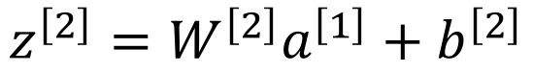
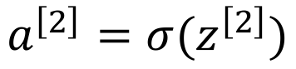
Activation function
$$x_{1}$$
$$x_{2}$$
$$\hat{y}$$
$$x_{3}$$
Given x:
$$z^{\left[1\right]}=W^{\left[1\right]}x+b^{\left[1\right]}$$
$$a^{\left[1\right]}=g^{[1]}(z^{\left[1\right]})$$
$$z^{\left[2\right]}=W^{\left[2\right]}a^{\left[1\right]}+b^{\left[2\right]}$$
$$a^{\left[2\right]}=g^{[2]}(z^{\left[2\right]})$$

Slide 50

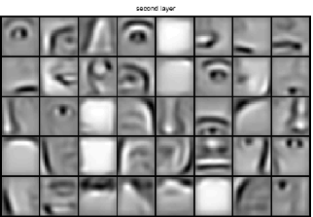
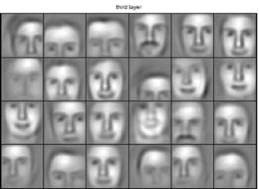
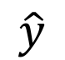
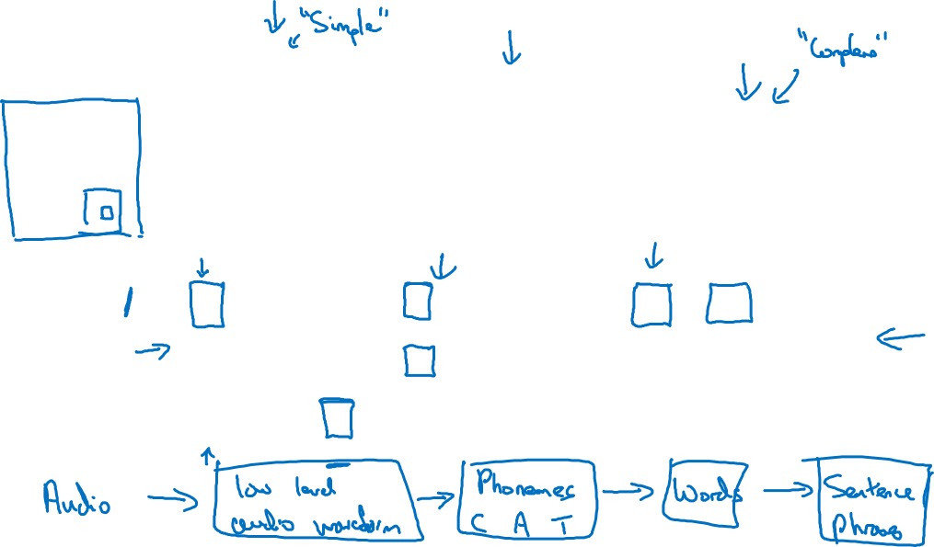
Intuition about deep representation
$$\hat{y}$$

Slide 51
Deep Neural Networks
Building blocks of
deep neural networks

Slide 52
Forward and backward functions
$$x_{1}$$
$$x_{2}$$
$$\hat{y}$$
$$x_{3}$$
$$x_{4}$$

Slide 53
Forward and backward functions

Slide 54
Forward propagation for layer l
Input $a^{[l−1]}$
O$utput a^{[l]},$cache ($z^{[l]}$)

Slide 55
Backward propagation for layer l
Input ${da}^{[l]}$
O$utput {da}^{\left[l−1\right]},dW^{\left[l\right]},db^{[l]}$

Slide 56
Summary

Slide 57
What are hyperparameters?
Parameters: $W^{\left[1\right]} ,{ b}^{\left[1\right] }, W^{\left[2\right]} ,b^{\left[2\right] },W^{\left[3\right] }, b^{\left[3\right] }…$

Slide 58
Setting up your ML application
Train/dev/test
sets
deeplearning.ai

Slide 59
Train/dev/test sets

Slide 60
Mismatched train/test distribution
Training set:
Cat pictures from webpages
Dev/test sets:
Cat pictures from users using your app
Not having a test set might be okay. (Only dev set.)

Slide 61
Bias and Variance
high bias
“just right”
high variance

Slide 62
Bias and Variance
Cat classification
Train set error:
Dev set error:

Slide 63
Regularization techniques
L1, L2
Dropout
Data Augmentation
Early Stopping

Slide 64
Setting up your optimization problem
Normalizing inputs
deeplearning.ai

Slide 65
Normalizing training sets
$x_{2}$
$x_{2}$
$$3$$
$x_{2}$
$x_{1}$
$x_{1}$
$x_{1}$
$$5$$

Slide 66
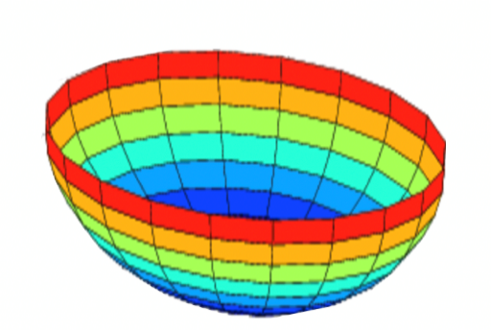

Why normalize inputs?
$$J\left(w,b\right)=\frac{1}{m}$$
$$\sum_{i=1}^{m}{ }$$
$$ℒ ({\hat{y}}^{\left(i\right)},y^{(i)})$$
Unnormalized:
Normalized:
$$J$$
$$J$$
$$w$$
$$w$$
$$b$$
$$b$$
$$b$$
$$b$$
$$w$$
$$w$$

Slide 67
Optimization algorithms
Gradient descent
Mini-batch gradient descent
Stochastic gradient descent
RMSPROP
ADAGRAD
ADAM

